Slide 1
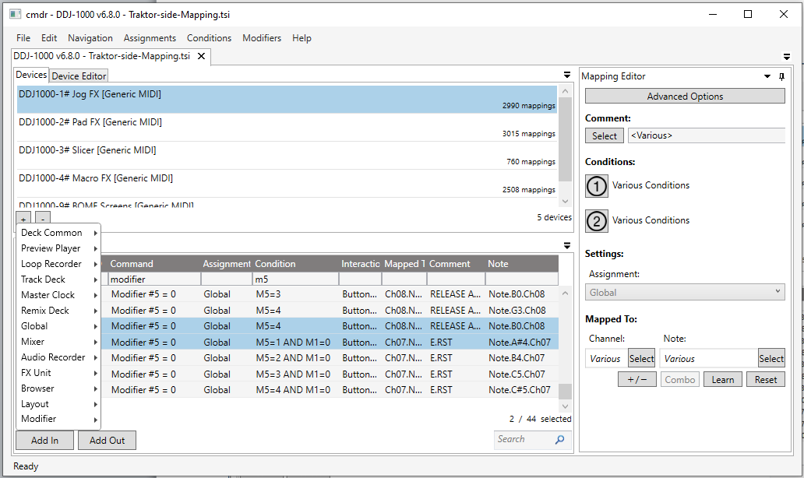
CMDR: Mapping Editor for Traktor Pro 3 (Windows)

Slide 2
January 2020 improvements:
Easy rotate Assignments, Conditions and Mods
TP3 and S4Mk3/etc support
Comment selector
Traktor order
Quick filters
Sort by notes besides channels
No Fade-in

Slide 3
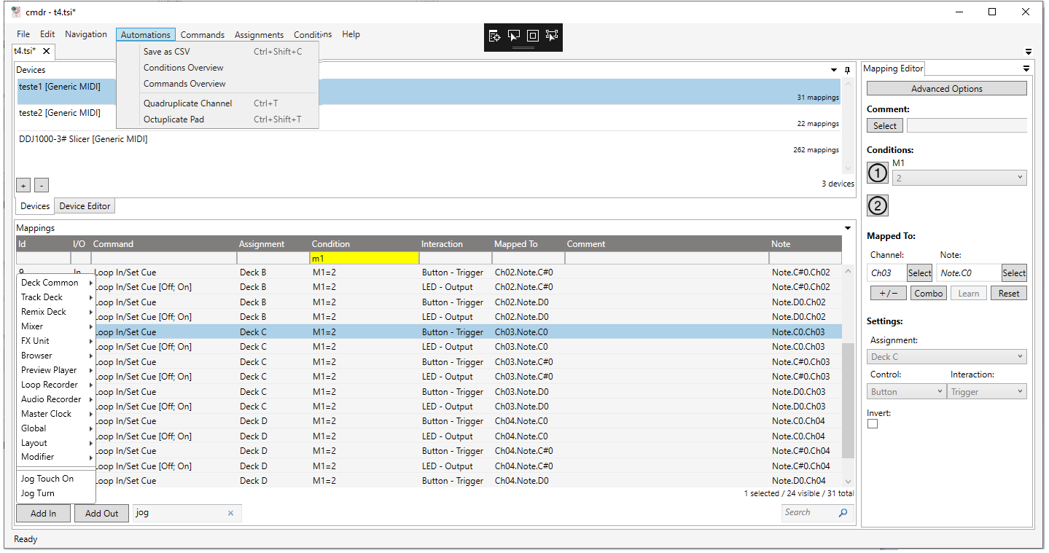
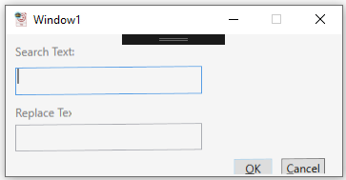
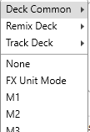
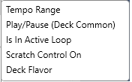
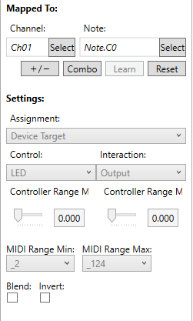
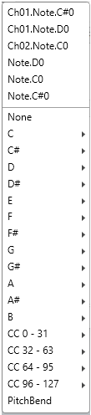
April 2020 improvements:
Save CSV
2x Reports
32 commands Auto Generated !! (4 channels+decks x 8 Pads)
Search/Replace Comments
Most used conditions
Shortcuts to channel+note
No sub-sub-trees anymore
Search commands
Yellow Filters Clear filters when changing pages
Shows filtered count
Search commands
MidiOUT no scrollbar!

Slide 4
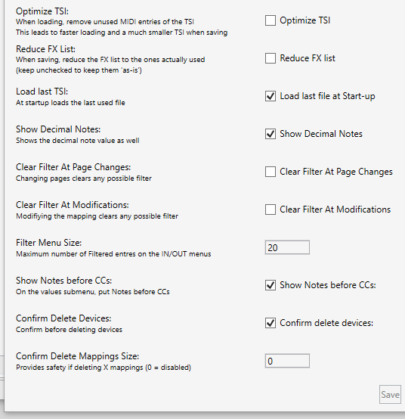

April 2020 NEW SETTINGS:
New icon
10 NEW SETTINGS
(explanation on the left)

Slide 5
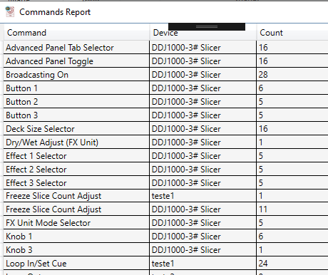
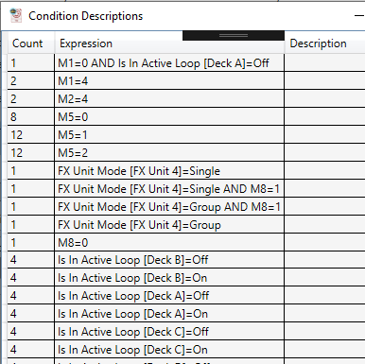
SHOWS ALL COMMANDS IN ALL PAGES Answers “where is command X”
SHOWS ALL CONDITIONS
Useful to find unused modifiers

Slide 6
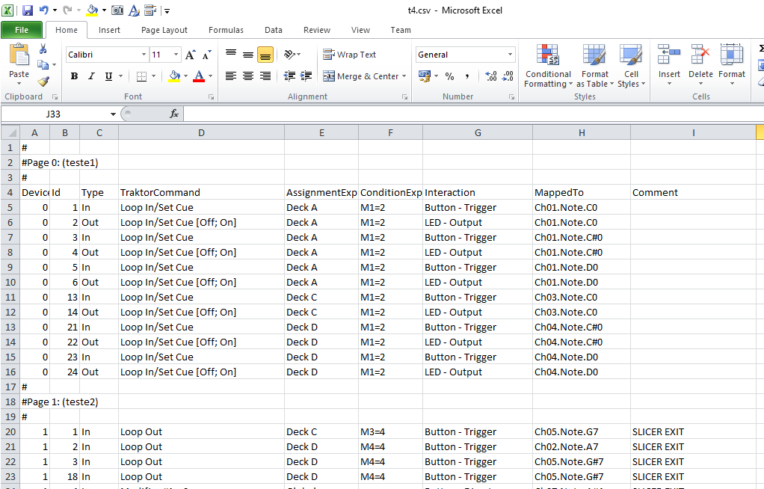
CSV EXPORT (useful for diff, grep, etc)

Slide 7
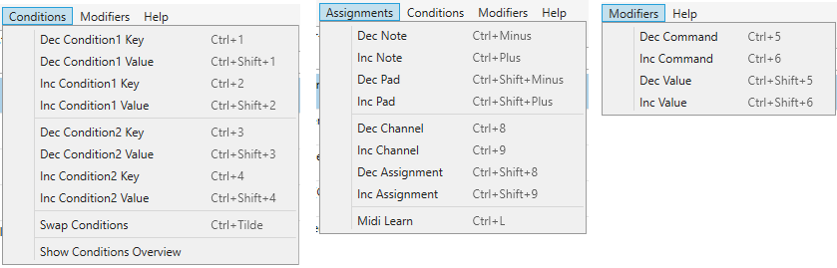
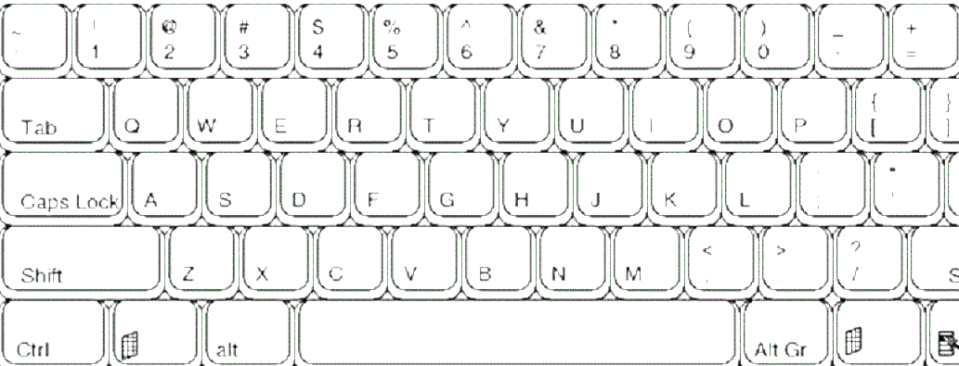
Swap Cond
Condition1 --/++
Condition2 --/++
Command --/++
Channel --/++
Note --/++
All/None
Value1 --/++
Value2 --/++
Value --/++
Assignment --/++
Pad --/++
Clear grid
Close
remove
4x channels
Open
Go top
8x pads
Select All
Midi Learn
Go bottom
CTRL+Shift
Cut
Copy
Paste
New
CTRL
Next+L
(Prev)
Set1
(Del1)
Set2 (Del2)
Set3
(Del3)
Set4
(Del4)
Jump
A+B ->
Play/ Pause
Cue
Zo --
(|)
Zoom ||s
Tick
(Auto)
Seek
<<-
Seek
<-
Seek
->
Seek
|
Grid <-
(<<-)
Grid ->
(->>)
Set
(Del)
BPM <-
(<<-)
BPM ->
(->>)
Play
Pause

Slide 8
